Slide 1
Water cycle
8-28-19

Slide 2
Water Cycle
includes precipitation, evaporation, transpiration, condensation, surface-water flow, and groundwater flow
Water is always moving between the atmosphere (troposphere) and surface of Earth.
Each components of the water cycle process has certain conditions under which each form of precipitation develops:
MENU

Slide 3
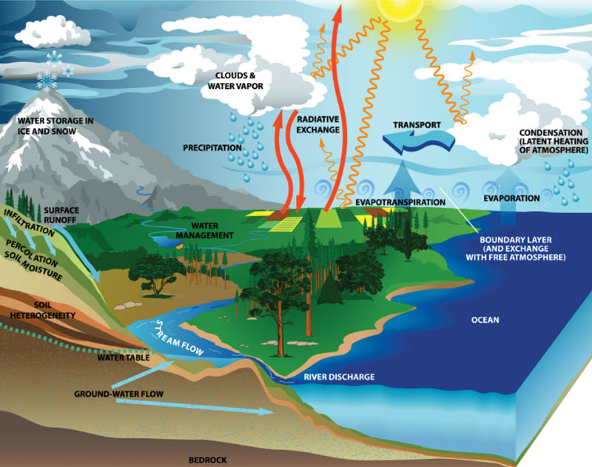
MENU

Slide 4
Water Cycle
Precipitation
· After condensation occurs (forming clouds), water droplets fall in various forms of precipitation – rain, snow, freezing rain, sleet, or hail, depending upon weather conditions.
· Temperature variations within clouds and/or within the region between the cloud and Earth allows for the various forms of precipitation.
Water Cycle Animation
MENU

Slide 5
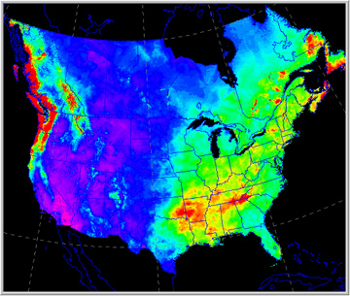
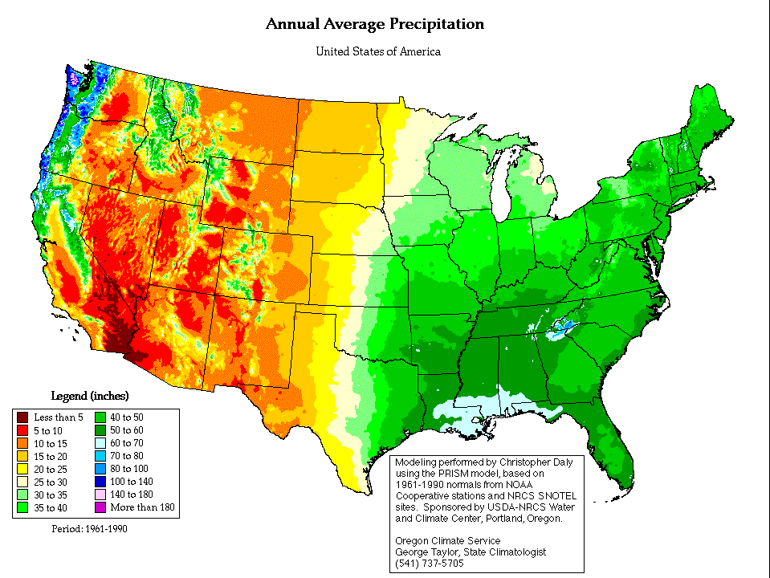
Precipitation
Rain & Drizzle- most common type of precipitation.
Freezing Rain- drizzle from stratus clouds.
Freezing Rain- raindrops freeze when they hit the ground.
Sleet- raindrops that freeze before they hit the ground.
Waters 3 States Video 6:52
MENU

Slide 6
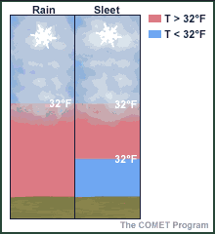
Sleet Profile
Precipitation
Water Cycle Animation
MENU

Slide 7
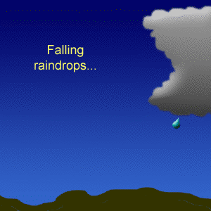
Precipitation
snow- as ice grows and merges into clouds they form snowflakes.
hail- is the largest type of precipitation.
Lumps or balls of ice that fall from cumulonimbus clouds in warm weather.
The Sun, Water Cycle, & Climate Video 2:37
The Water Cycle and Clouds Video 15:01
MENU

Slide 8
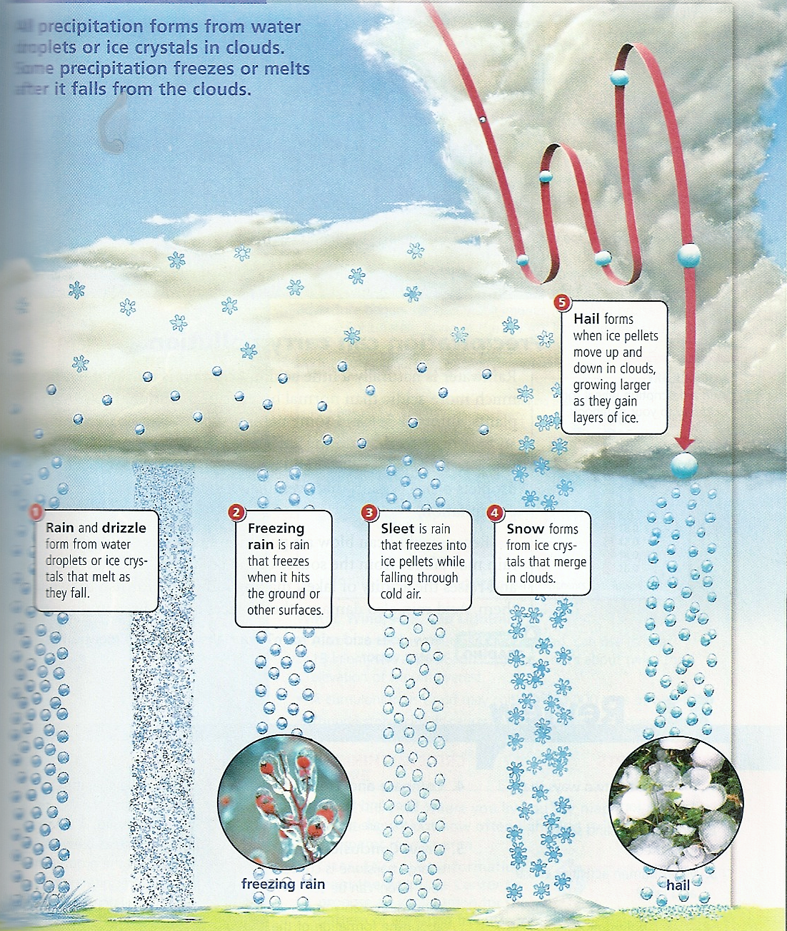
MENU

Slide 9
Water Cycle
Evaporation/Transpiration
· Water enters the atmosphere as water vapor through evaporation and transpiration, plants releasing water vapor.
Humidity- the amount of water vapor in the air
Relative humidity- compares the amount of water in the air with the maximum amount of water vapor that can be present at that temperature
MENU

Slide 10
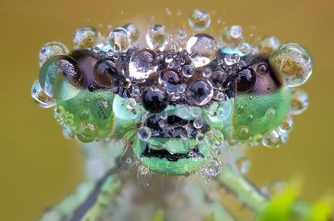
Water Cycle
· Condensation happens in the
atmosphere as water vapor
changes to water droplets.
· Clouds form as a result of
condensation.
· Dew forms when water vapor condenses directly onto a surface;
· Frost forms when water vapor changes from gas directly to ice crystals on a surface when the temperature at which condensing would take place is at the freezing point or below.
Solid, Liquid, Gas Video 2:50
MENU

Slide 11
Water Cycle
Run-off
· If precipitation falls on land surfaces, it always attempts to move back toward sea level as surface-water flow or groundwater flow.
· The surface that receives the precipitation determines its flow back towards sea level.
Groundwater Story Animation
MENU

Slide 12
Examples are:
· Water will remain on the surface when the surface is not porous or the precipitation is falling too fast for the water to sink into the ground.
· Water will sink into the ground when the surface is porous and there is lots of space in the soil to hold the water.
MENU

